Slide 1
British Geological Survey: Virtual Reality and GeoVisionary
Bruce Napier
Team Leader: Visualisation Systems

Slide 2
Overview
Introduction to BGS
Virtual Reality at BGS
GeoVisionary
GeoVisionary demonstration

Slide 3
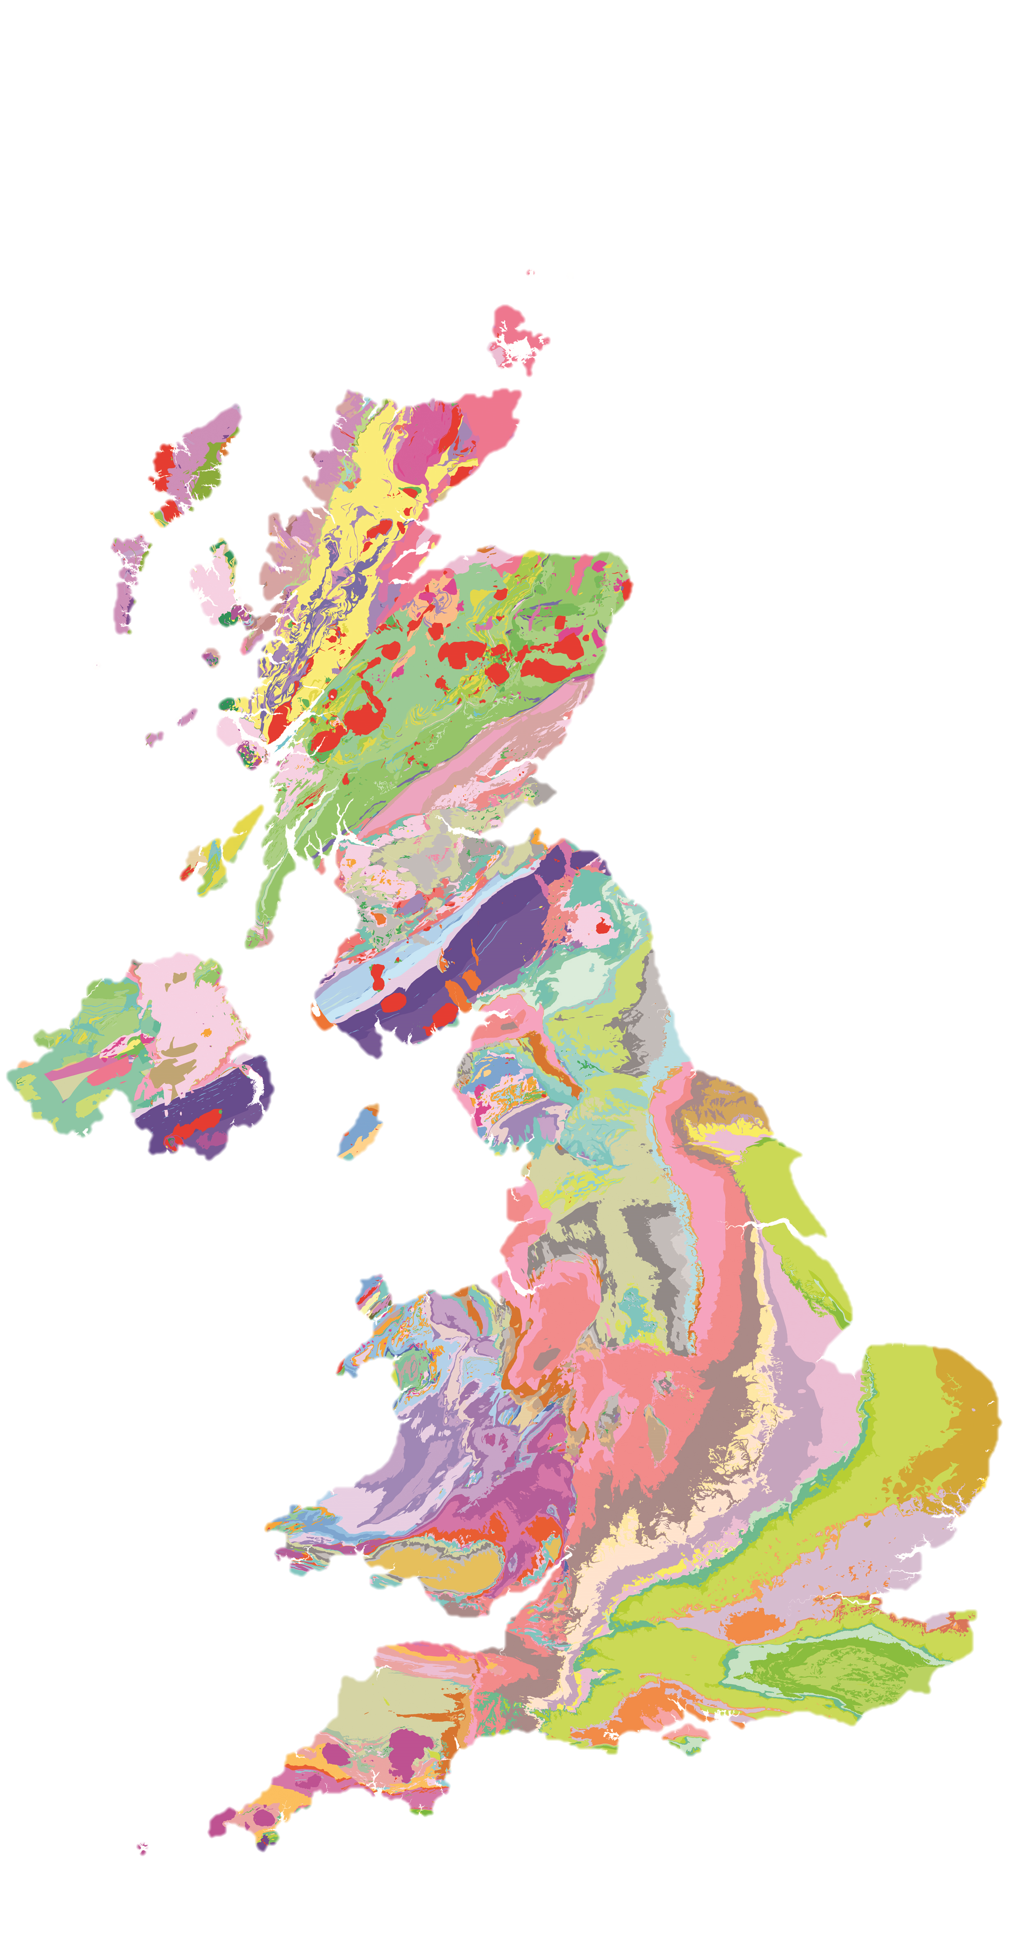
British Geological Survey
National geological survey founded in 1835
UK custodian of geoscientific information
Independent
600 staff
Part of UKRI, a not-for-profit public sector research establishment
Funded by Government & external income
Offices at Keyworth, Wallingford, Edinburgh & Cardiff

Slide 4
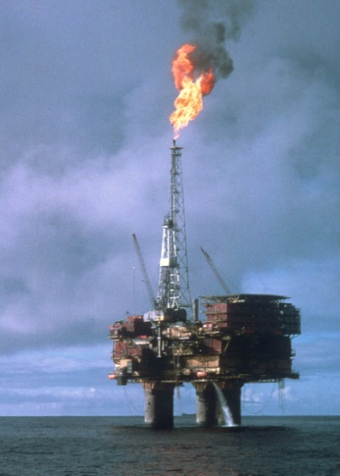
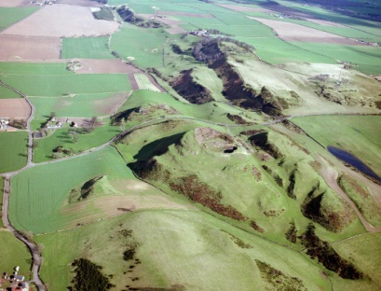
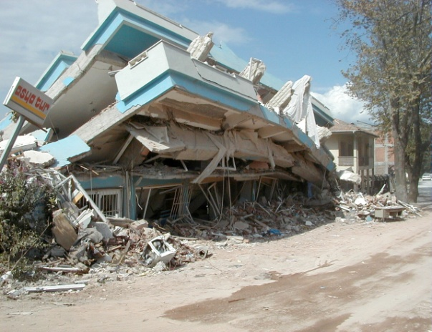
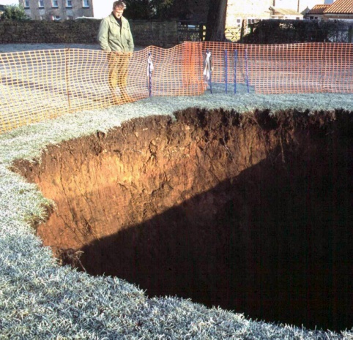
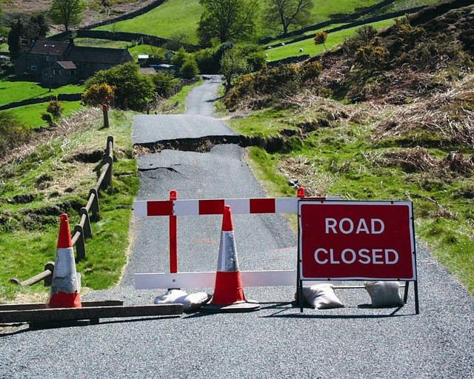
British Geological Survey
The British Geological Survey is a world-leading geological survey. It focuses on public-good science for government, and research to understand earth and environmental processes. It is the UK's premier provider of objective and authoritative geoscientific data, information and knowledge to help society to:
use its natural resources responsibly
manage environmental change
be resilient to environmental hazards
The BGS provides expert services and impartial advice in all areas of geoscience. Our client base is drawn from the public and private sectors both in the UK and internationally.

Slide 5
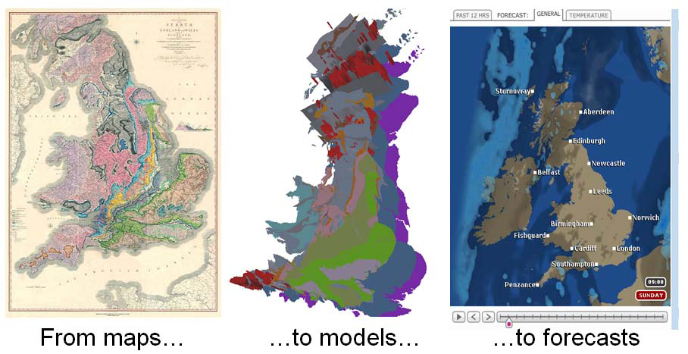

Slide 6
BGS Expertise
Earth Hazards
Geological mapping
Energy
Information and Data Management
Minerals and waste
Engineering geology
Mobile and web apps
Virtual reality
Earth observation
Marine geology + coastal erosion
3d geological modelling
Groundwater
Geoscience technology
UAV
Environmental monitoring
Digital workflows

Slide 7
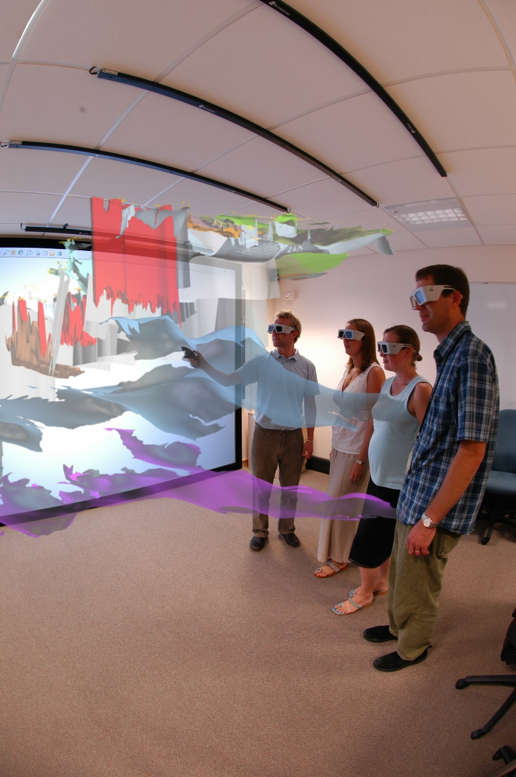
Virtual Reality At BGS
First immersive 3D Visualisation Facility
February 2005
Virtalis Stereoworks
Christie projector: 1400 x1050 pixels @ 100Hz, 4000 lumens
Main use: display of 3D models from Digital Geoscience Spatial Model Programme

Slide 8
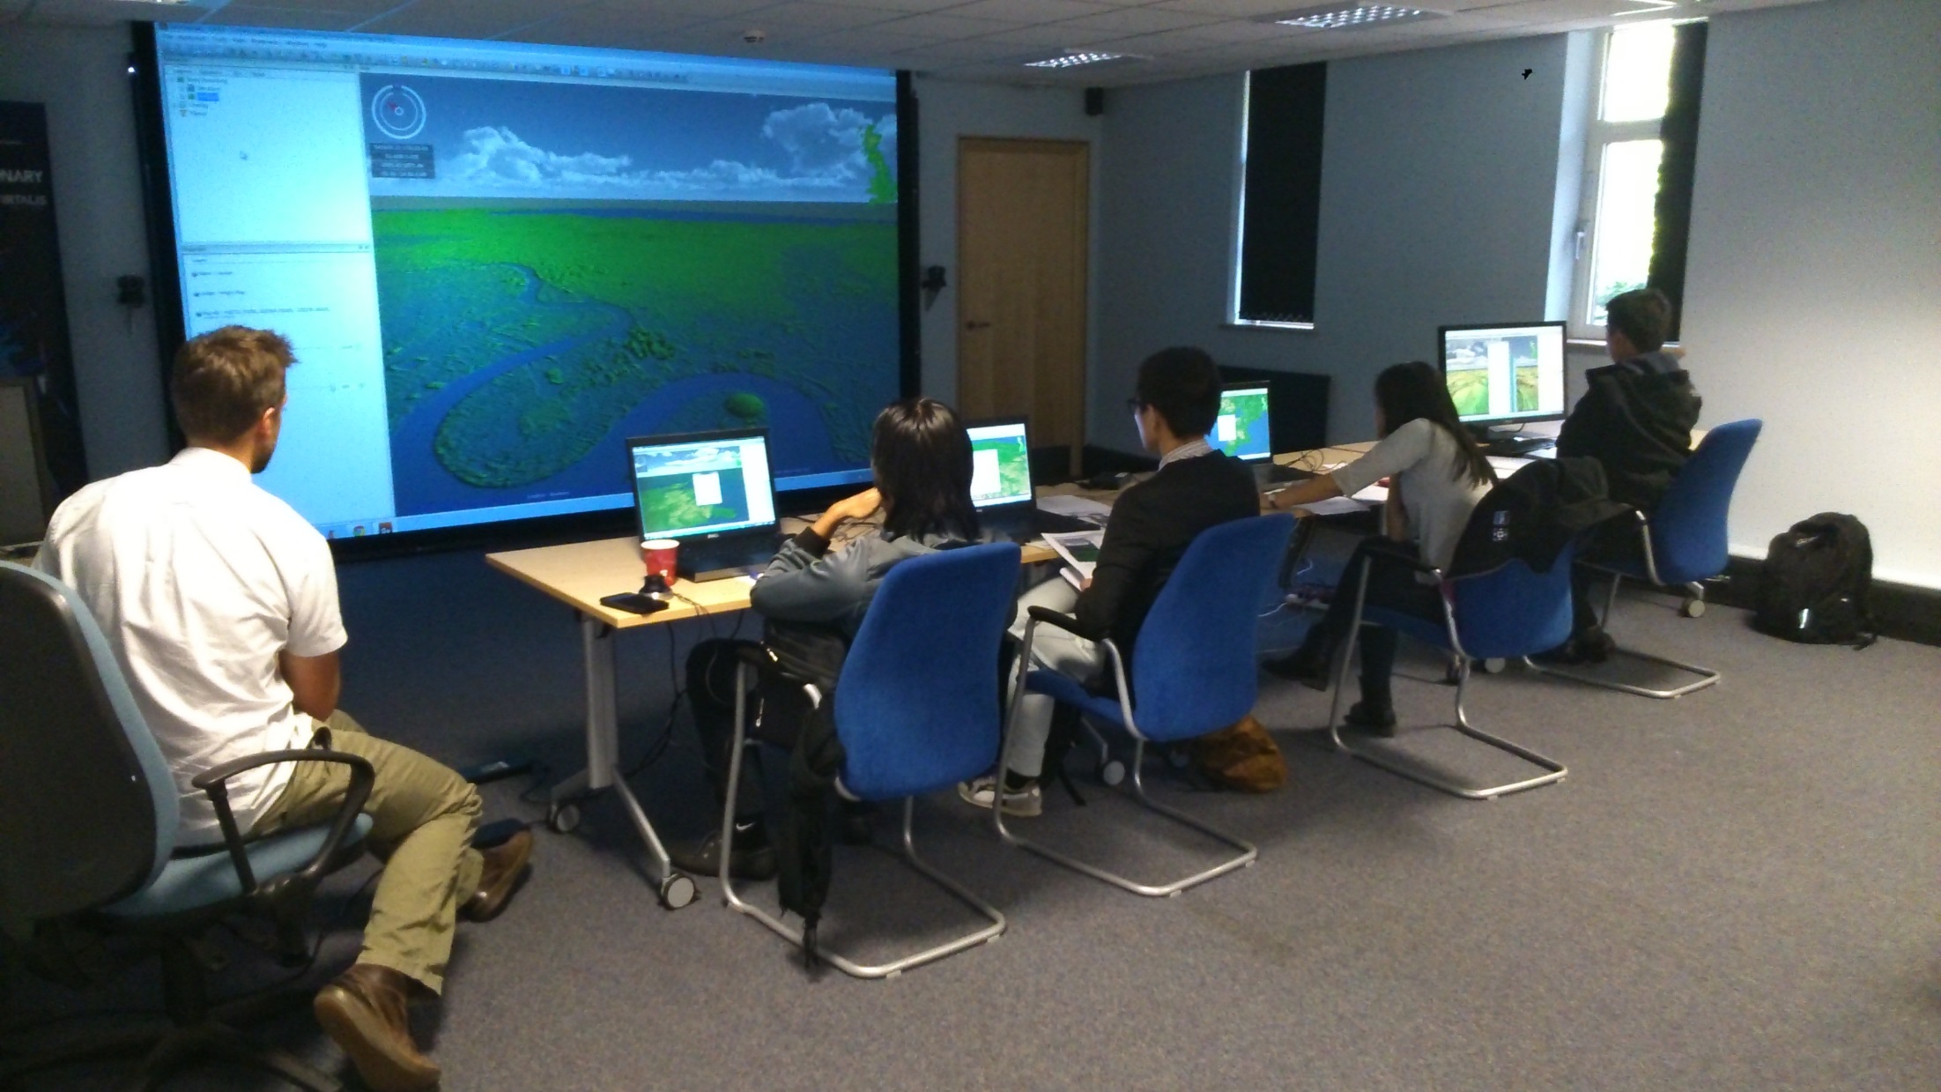
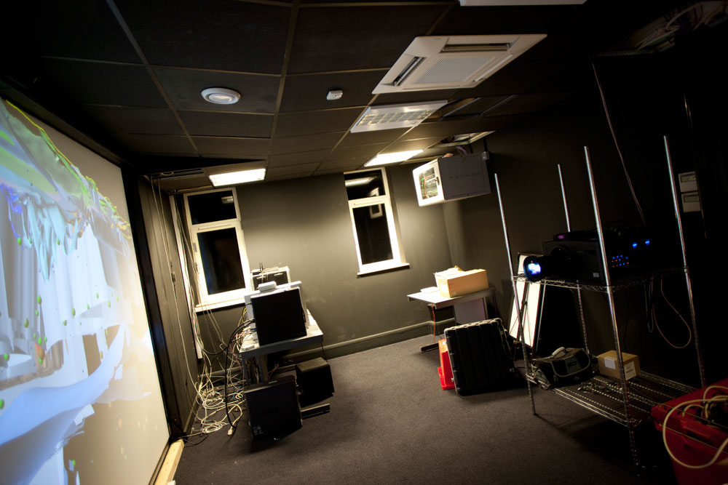
VR @ BGS
i3DVF v2 – 2007
Virtalis StereoWorks
Christie WU7 1920 X 1200, 7000 lumens, 120Hz active stereo
More practical uses… Virtual fieldwork…team model building…training

Slide 9
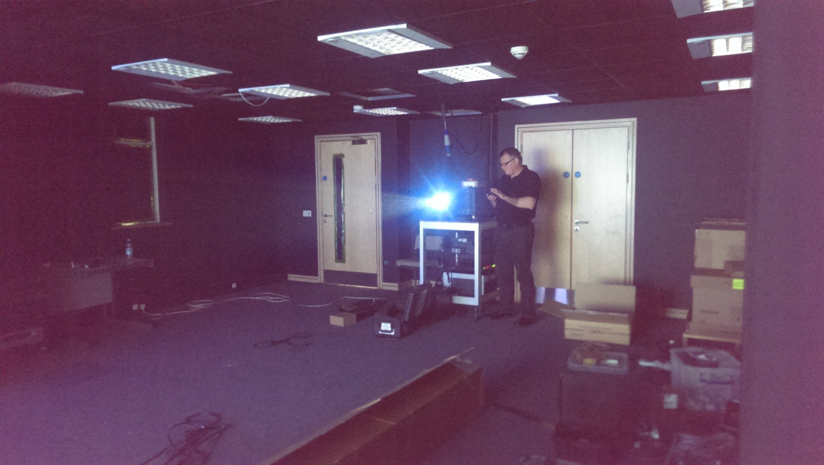
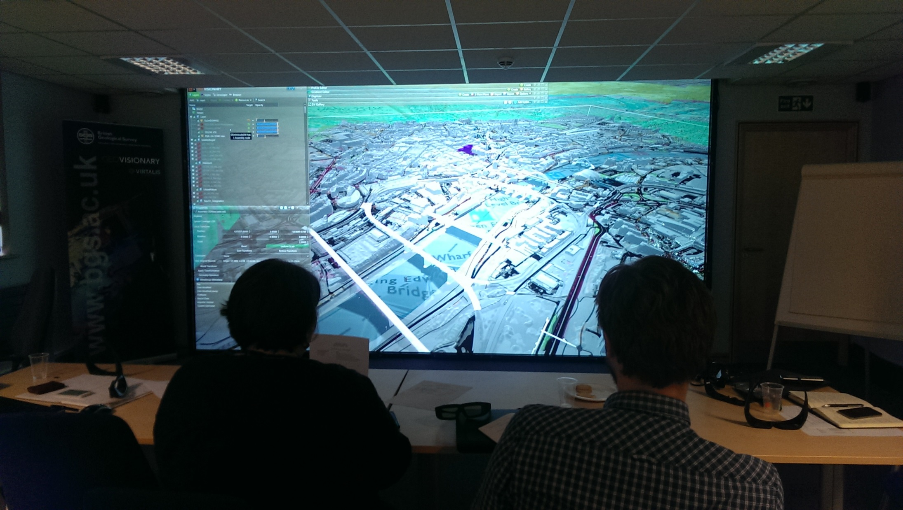
VR @ BGS
i3DVF v 3
2016
Virtalis ActiveWall – Christie Boxer 4K30
Full 4K resolution + 30000 lumens@ 120 Hz

Slide 10
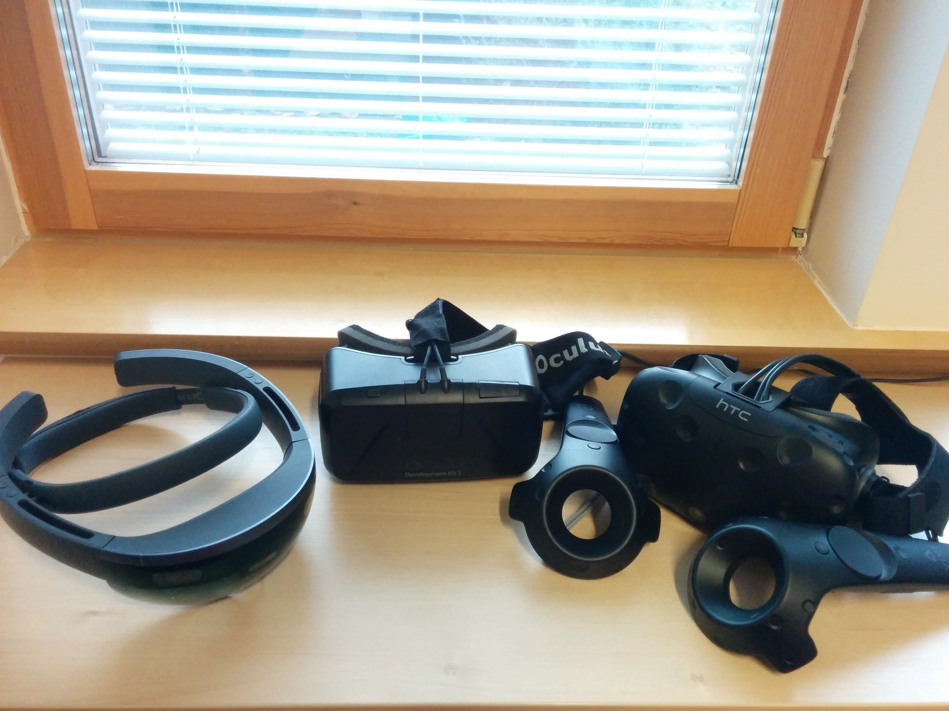
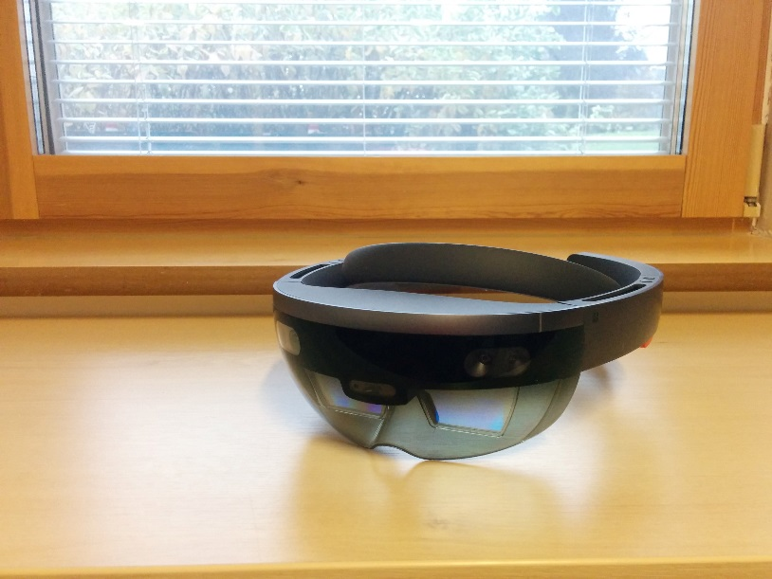
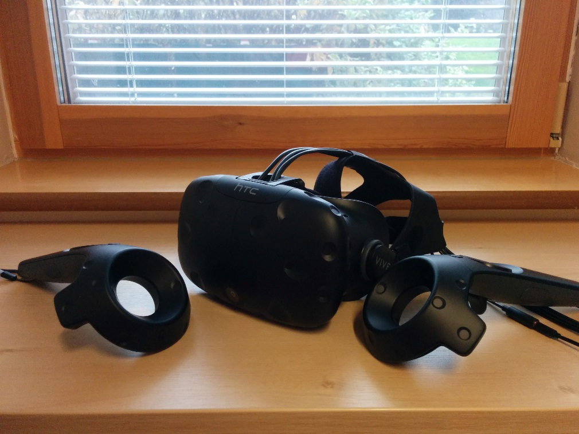
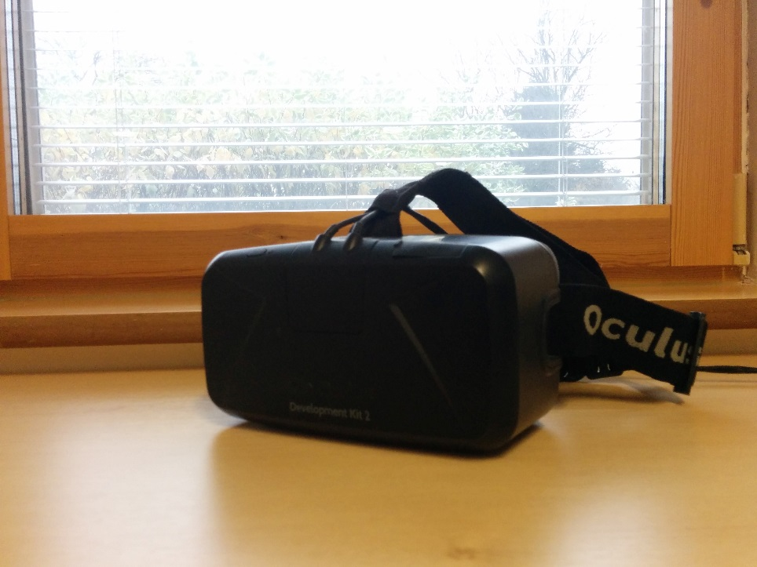
VR headsets – the future?

Slide 11
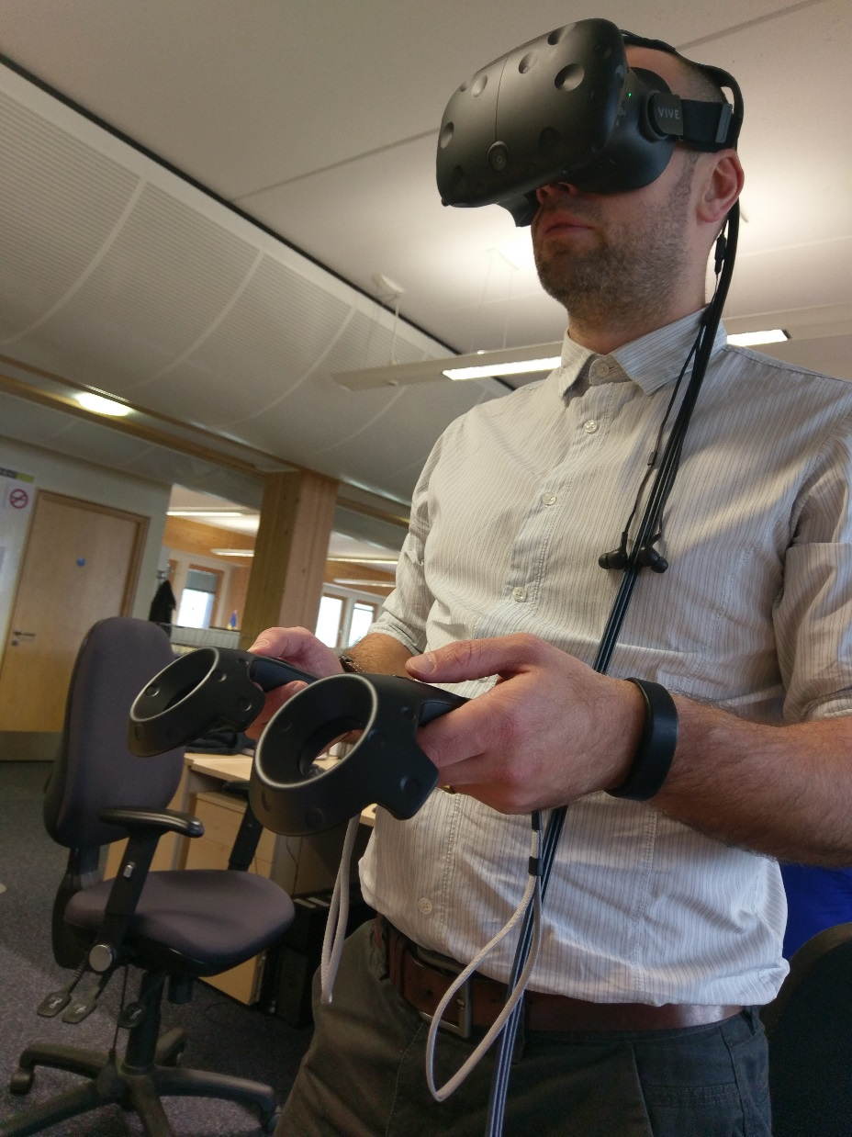
VR headsets…
Useful low cost visualisation
Immersive
Not so good for working together…

Slide 12
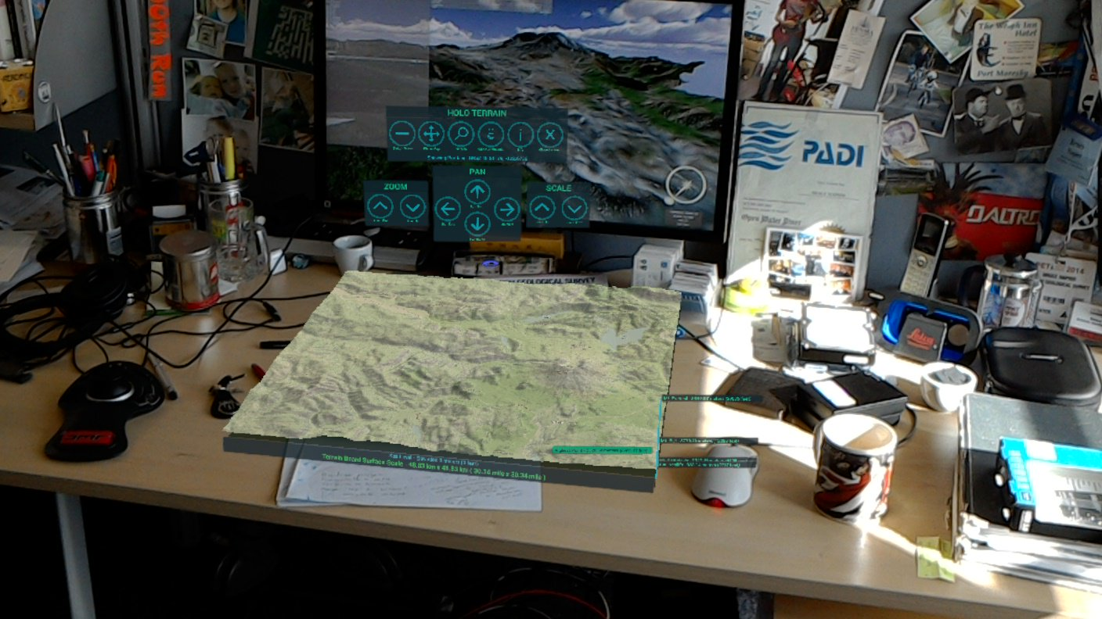

Slide 13
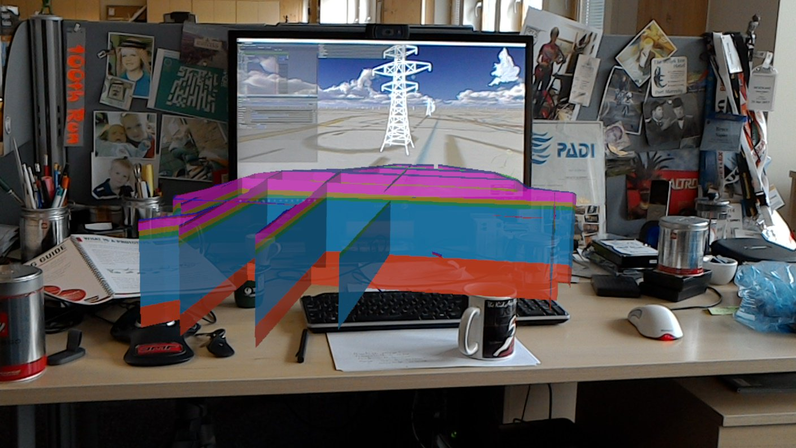

Slide 14
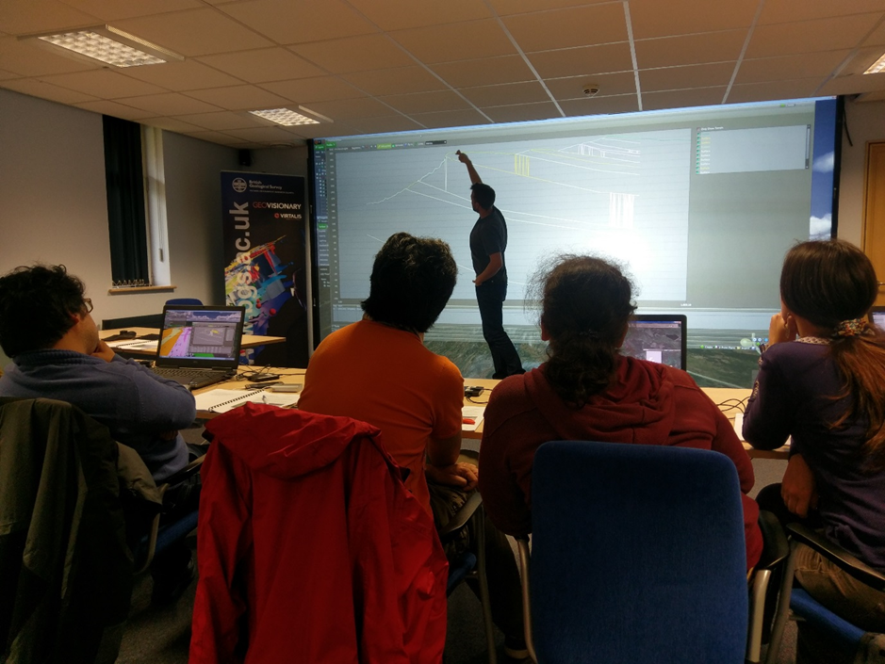
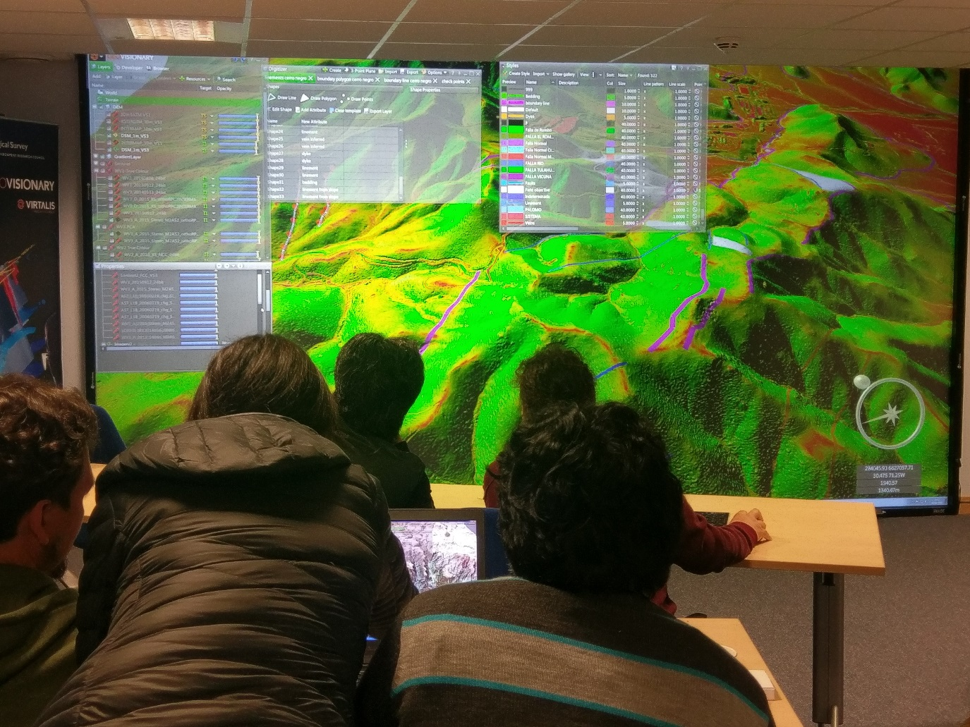
3D visualisation room…
Best for working together
Immersive and engaging
Easy on the eyes for working

Slide 15
HMD vs 3D room…
Both can provide great VR experience
3D room is better for group working and presentation
Headsets – more for solo use – shared remote sessions?
Hololens and mixed reality might change the headset experience

Slide 16
Why do we invest in VR?
Great working environment to understand, interpret and communicate complex 3D information – a common visual language
Greatly increased fieldwork efficiency – make better, faster decisions
Impressive for presentations

Slide 17
GeoVisionary
Originated in BGS – Virtalis R&D collaboration
October 2006: VFR – virtual field reconnaissance – improve results and efficiency of fieldwork using VR technology
Solved the problem of utilising BIG datasets – terabytes of terrain and imagery

Slide 18

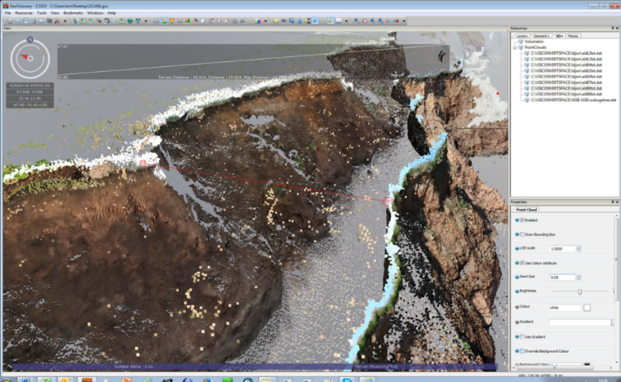
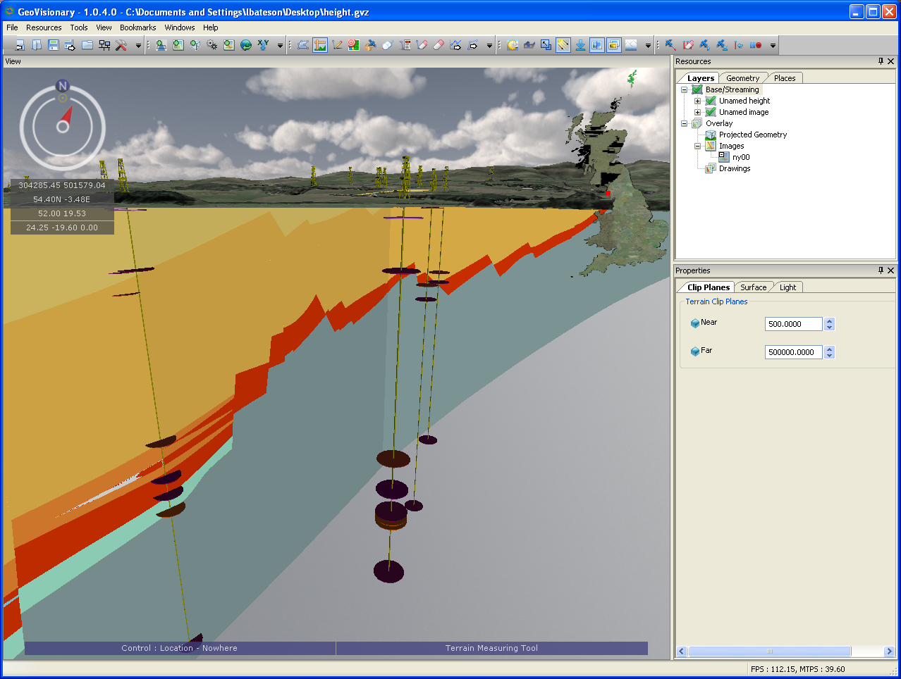
Data Integration:
BGS have lots of data of different types
Real value realised when data are integrated and interpreted as one
For the BGS Digital Workflow we initiated GeoVisionary with Virtalis:
Immersive virtual environment,
Combine any resolution of elevation data with:
imagery, 3D geological models, GIS layers, CAD models, etc
seamless movement through the datasets
Supports time
Virtual geological toolkit enables geoscientists to analyse and interpret data
Notes:
789 million points

Slide 19
GeoVisionary 3
Multiple terrains
Modify terrain with grid/shapefile
Combine land and bathymetry, excavation, dam or spoil heap
Web Services
WMS WFS WMTS JSON
Immersive headsets
Vive, Oculus Rift, etc
GPS tracking
Networking – connect remote GV installations
Digitize on any object in the scene
Borehole visualisation improvements – BGS Groundhog link – import from database
Instant slope and aspect maps
Weather
Scripting with LUA, C++, Python - create your own GV plugins

Slide 20
GeoVisionary - future
GVCloud – SaaS
Mixed reality – Azure Spatial Anchors?
More with live data and
More empirical

Slide 21
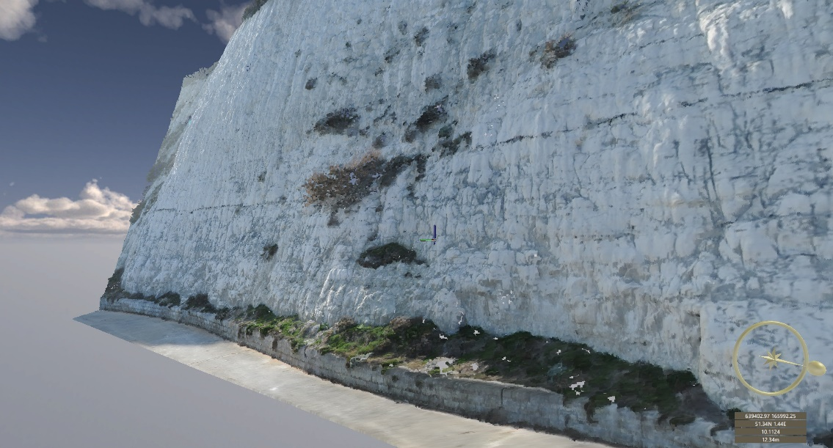

Slide 22
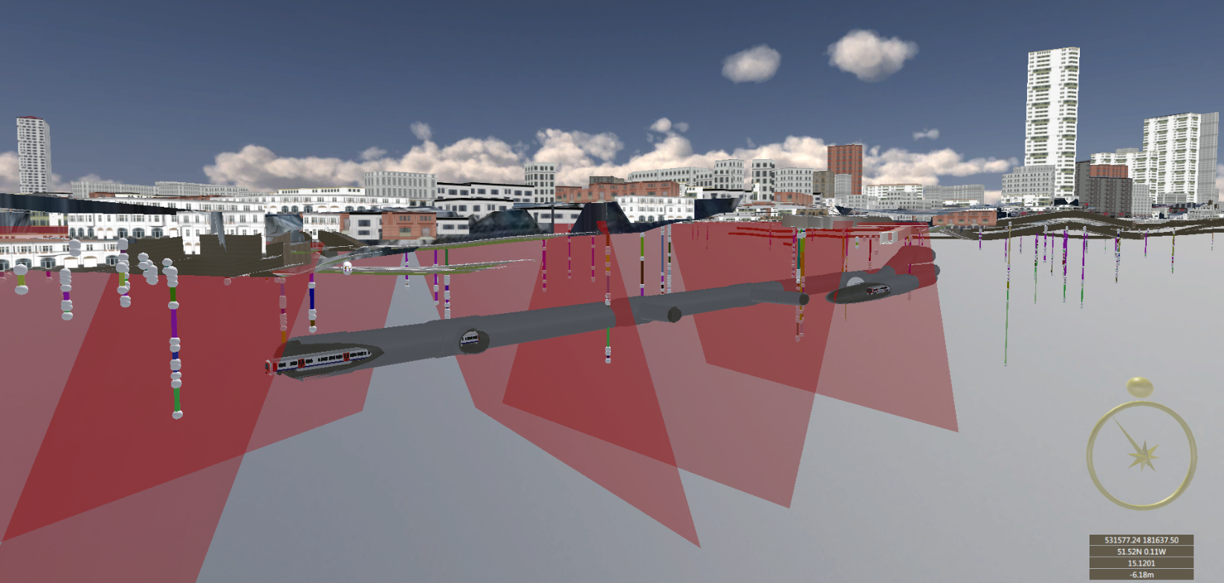
Example – Farringdon Station
Aldiss, D.T.; Black, M.G.; Entwisle, D.C.; Page, D.P.; Terrington, R.L. 2012. Benefits of a 3D geological model for major tunnelling works: an example from Farringdon, east-central London, UK. Quarterly Journal of Engineering Geology and Hydrogeology, 45 (4). 405-414

Slide 23
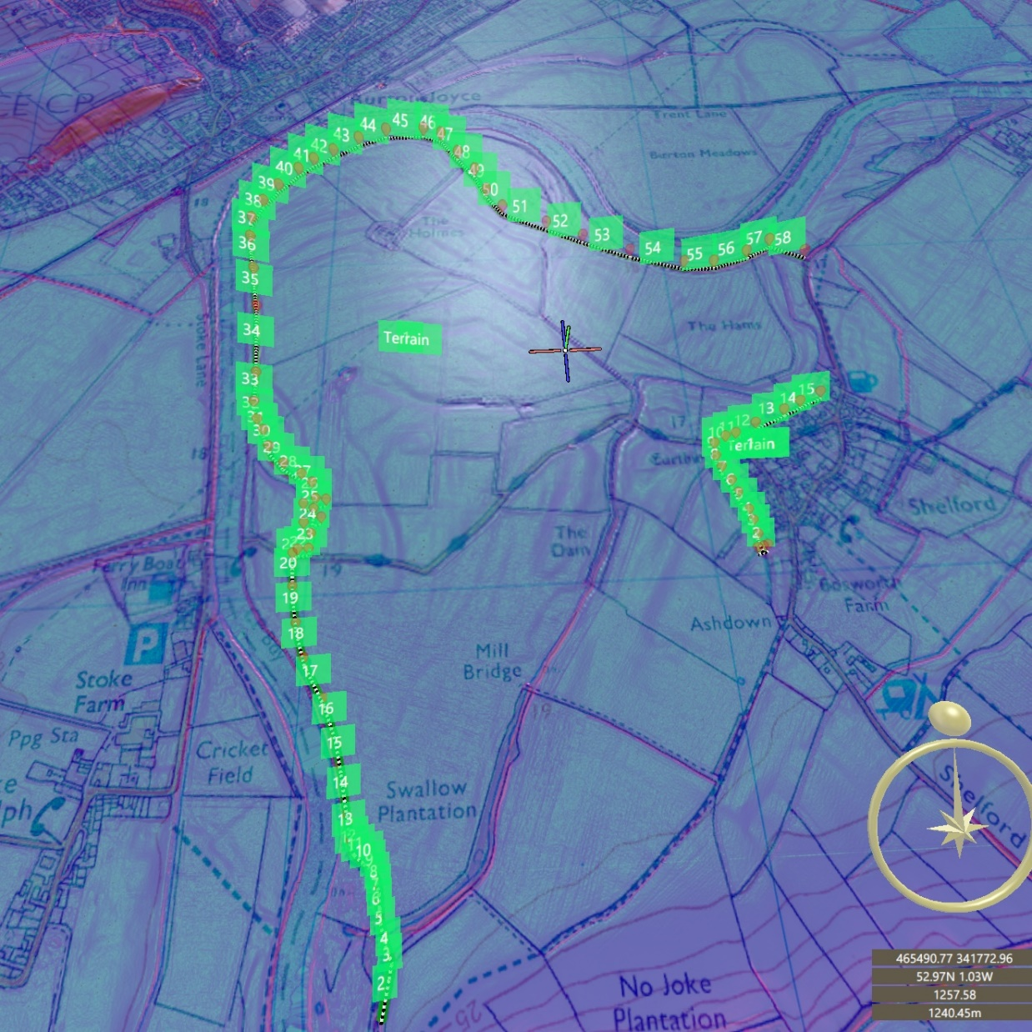

Slide 24
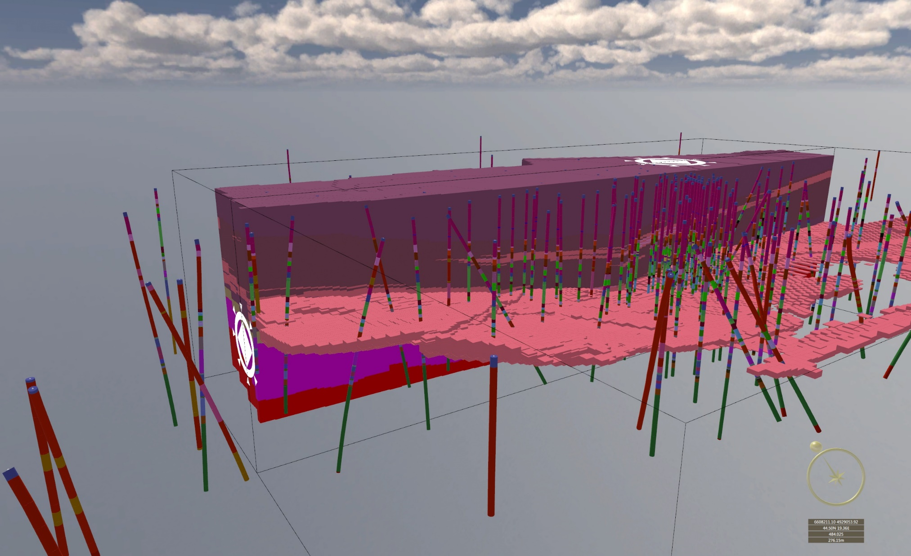

Slide 25
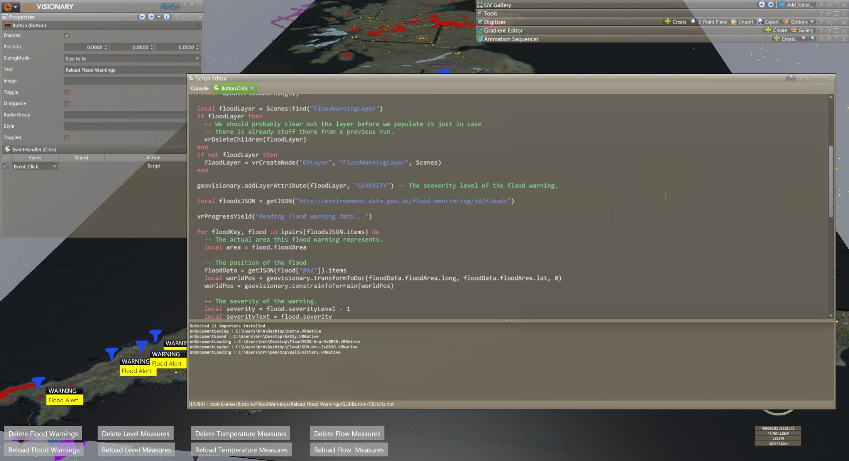

Slide 26
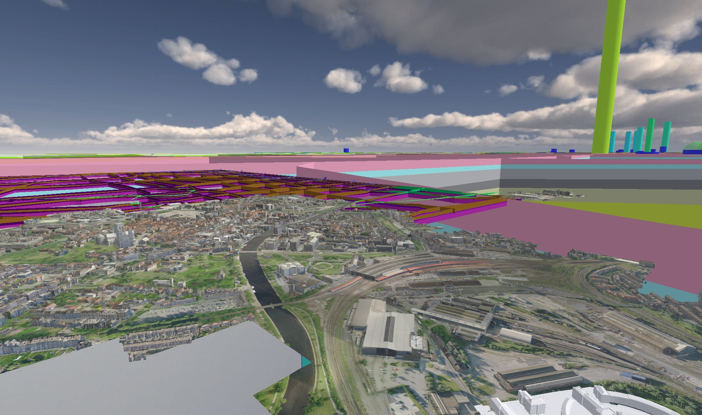

Slide 27
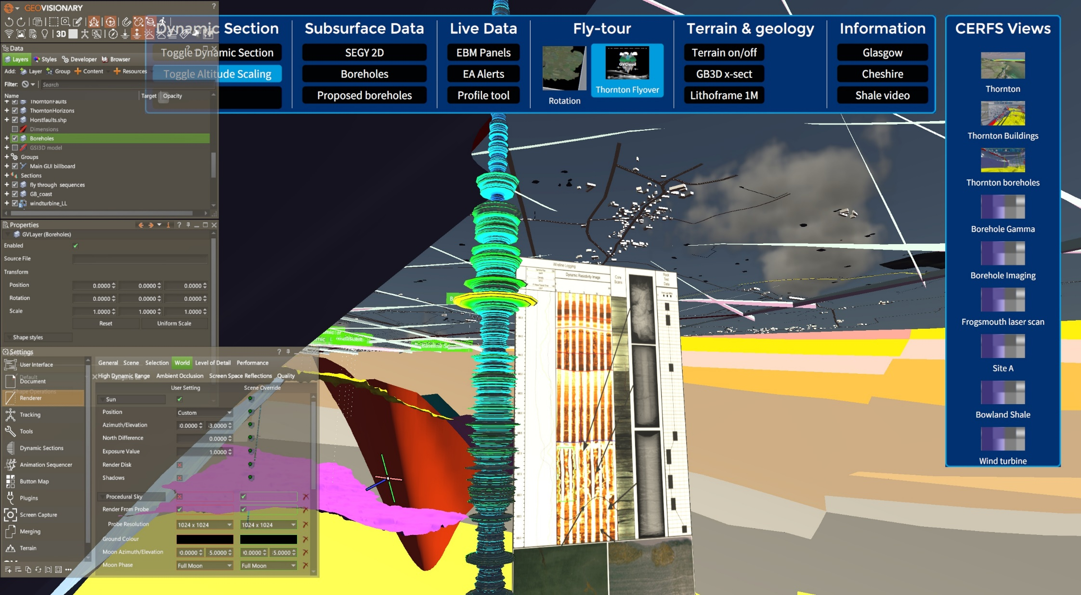

Slide 28
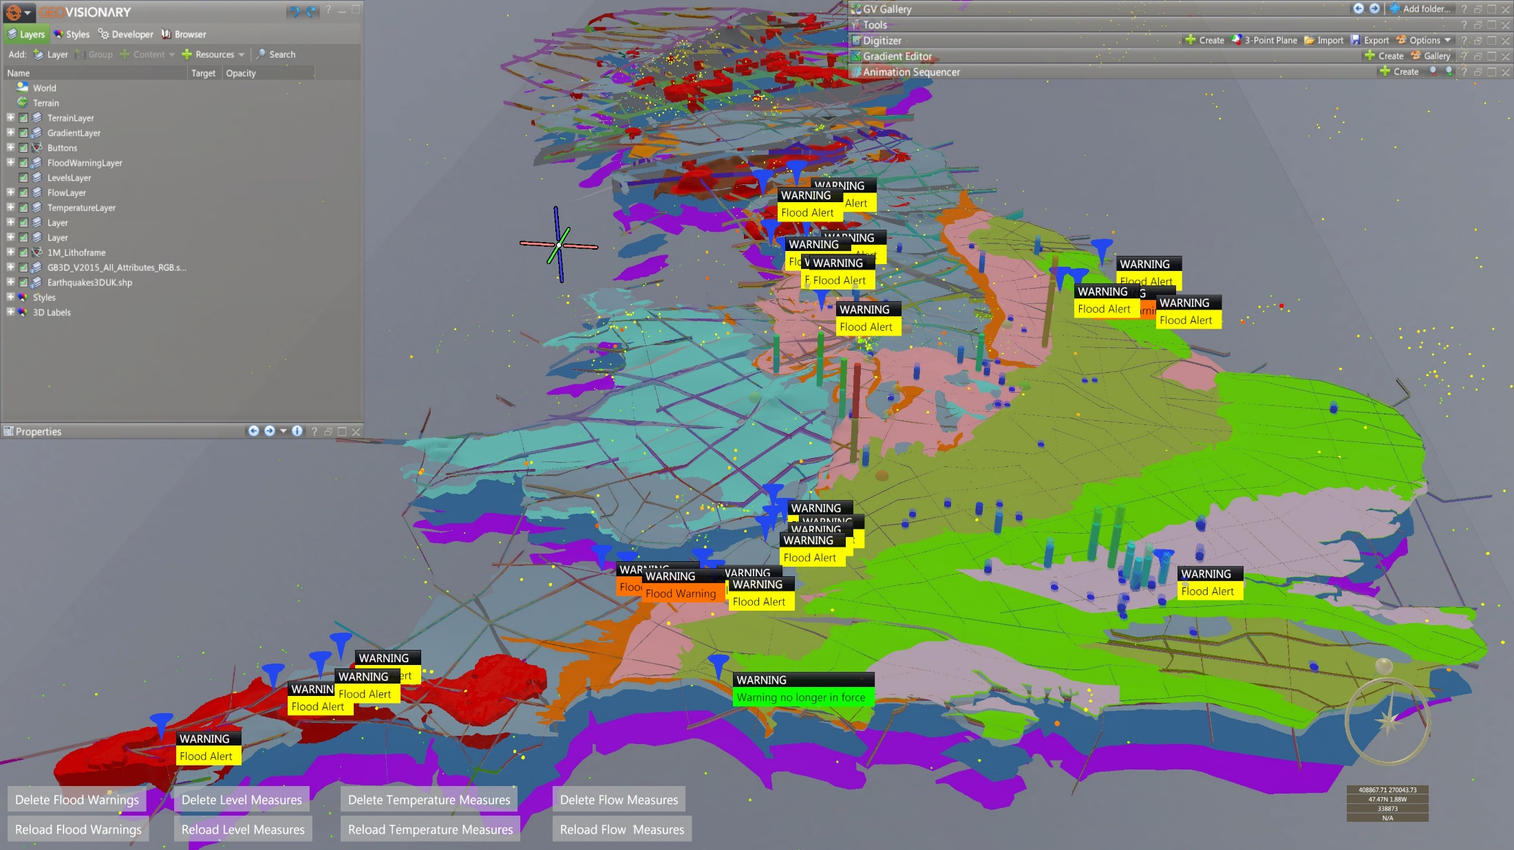

Slide 29
Thank you☺
GeoVisionary 3.1 demonstration…
Bruce Napier – brn@bgs.ac.uk

Slide 30
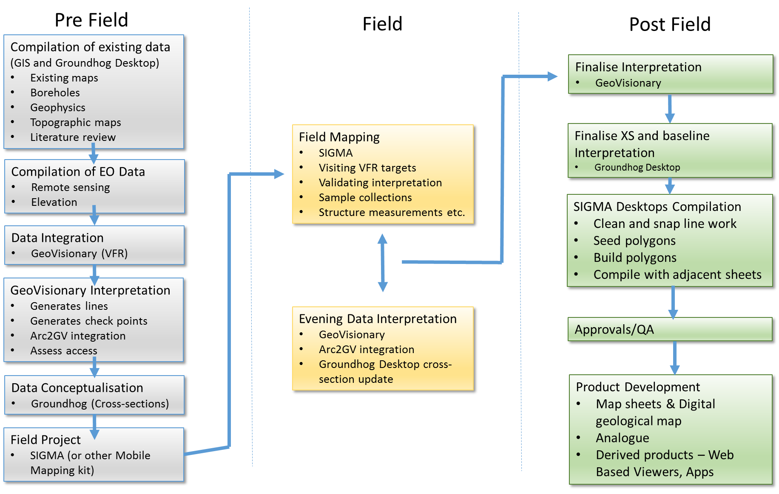
BGS VFR Workflow

Slide 31
GeoVisionary Training Course

Slide 32
Example Data Integration in GeoVisionary
Earth Observation DATA
1m Elevation model 10m elevation model 30m SRTM elevation model
World View satellite data
Quickbird
GeoEye
Sentinel-2
Landsat 7 and 8
Geological Data:
ESRI shapefiles for the following geological map sheets
Existing model data (drift thickness models etc)

Slide 33

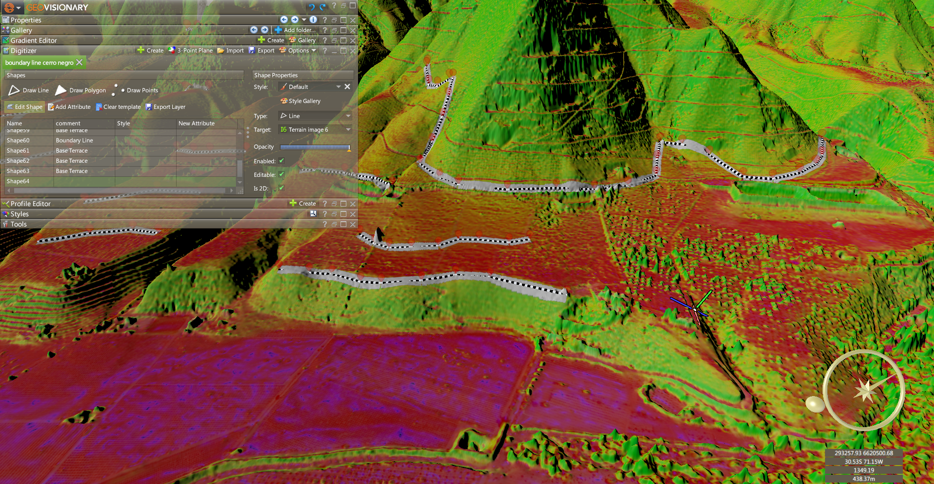
Pre-field Interpretation

Slide 34
Field Verification
Visit the identified check points:
Field observations were recorded in SIGMA as a Field Observation Points (FOP)
The information typically recorded into a FOP was:
Lithological interpretation
Comments
Structural measurements
Sketches and photographs
Logs
Any changes to the interpretation carried out in GeoVisionary before the field work were recorded in the Ground Truth Log.

Slide 35
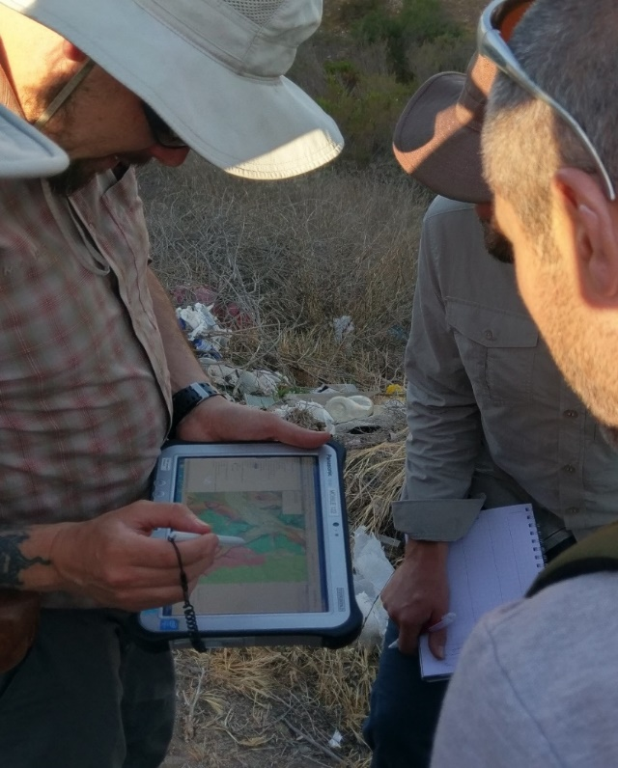
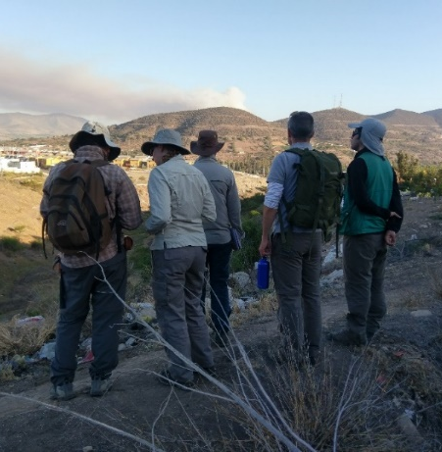
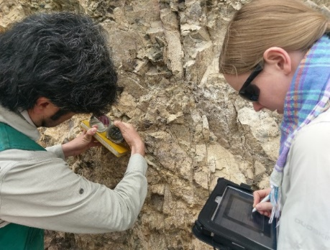
Field Verification

Slide 36
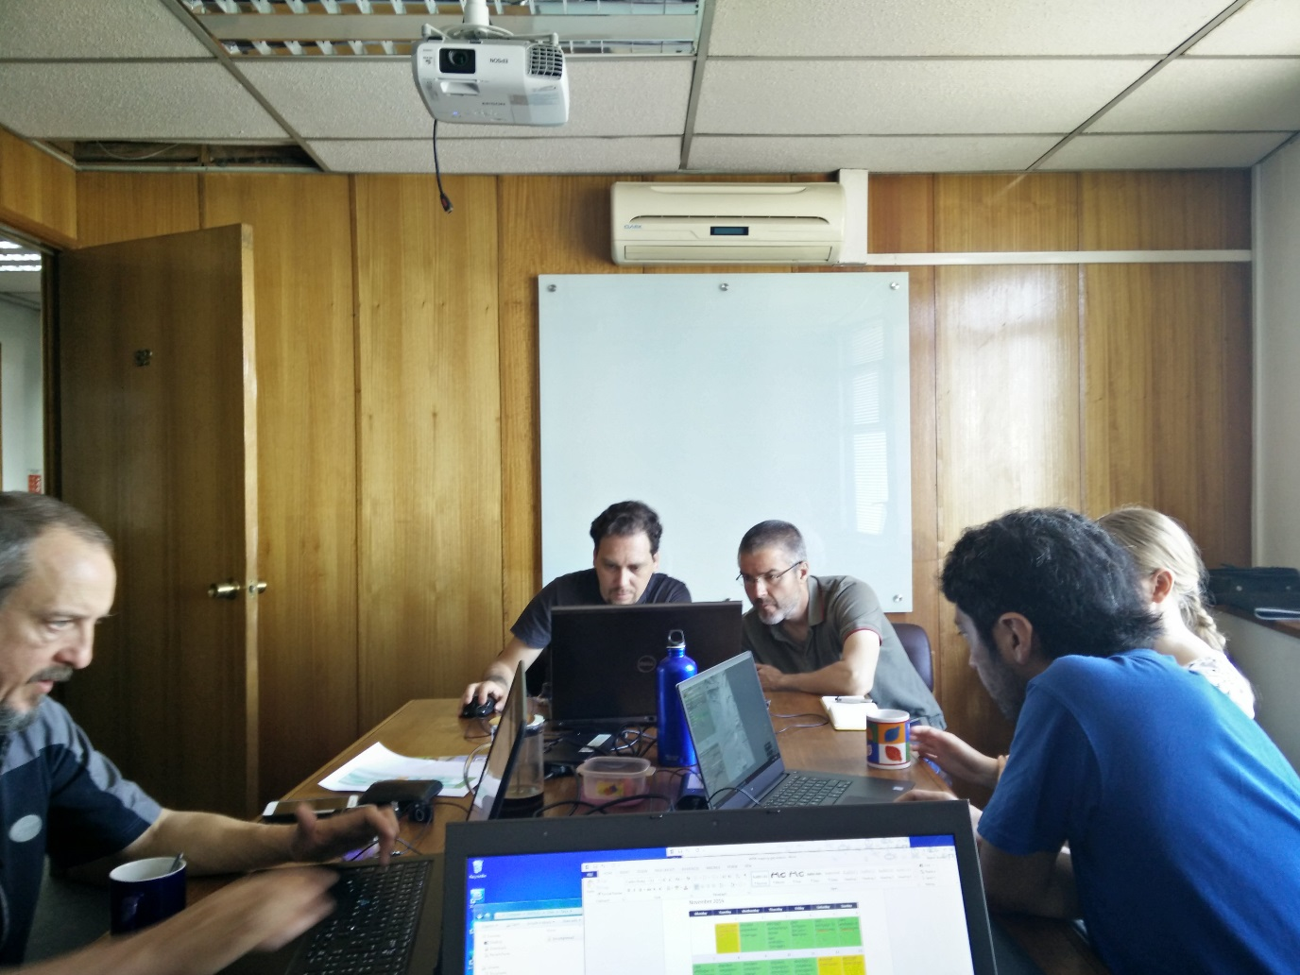
Post Field Map Compilation

Slide 37
Post Field Map Compilation
Using SIGMA desktop tools and GeoVisionary to finalise the interpretation;
existing geological maps used as a basis
boundaries were edited to match the VFR interpretations and field observations.
Line topology checked:
Closed polygons no node dangles.
Areas were then seeded using stratigraphical codes that were created to follow existing SGU attribution.
The seeding process adds an identifier to the polyline area to tell it what geological unit it should be.
Enclosed areas are then converted to polygons using the polygon building tool.
This process is repeated for each geological unit and a fully attributed topologically correct digital geological map dataset is the output.

Slide 38
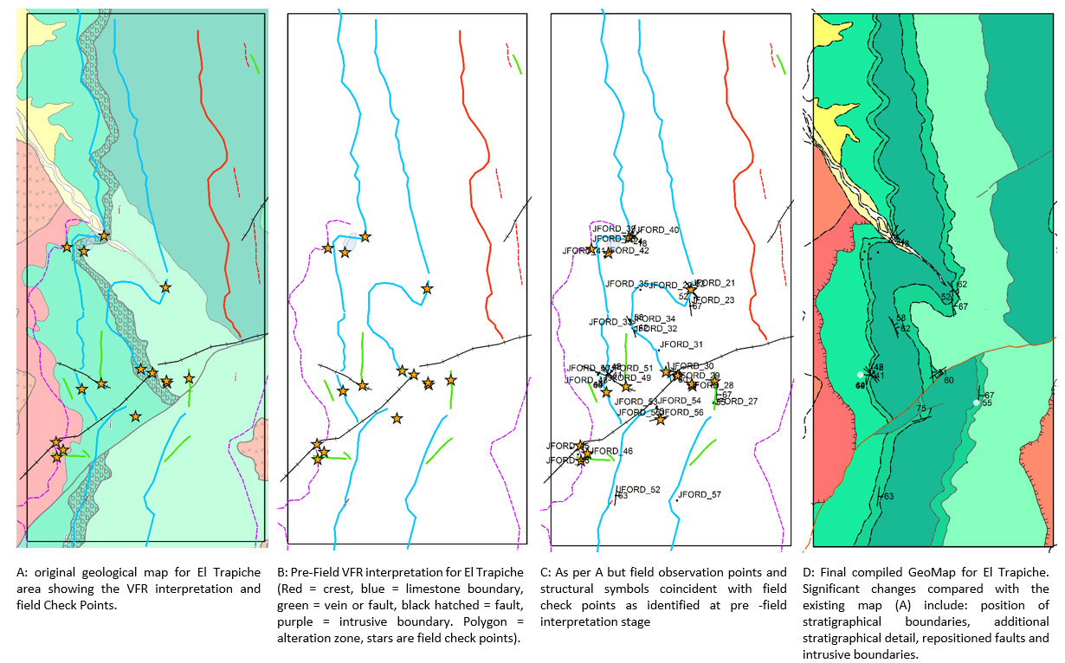
GeoMap data for El Trapiche

Slide 39
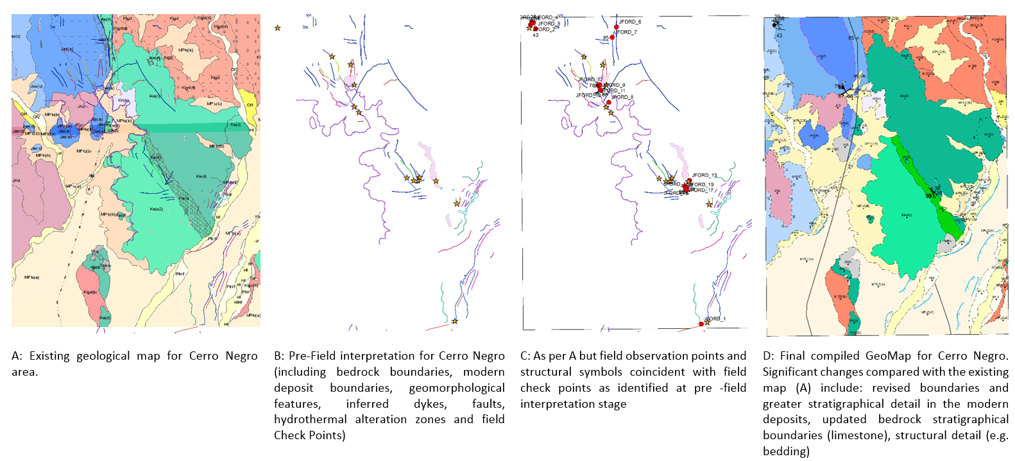
GeoMap data for Cerro Negro

